Slide 1

Project HeartBeat
Heart Disease
Prevention
By: S01 Group 5
Lum Shi Zhen U2210198H
Teo Man Ru Joleen U2111561F
Poh Lee Tin U2111981A
Sally Ngui Yu Ying U2222782A
Tenia Xu Yuan U2210808E

Slide 2
Table of Contents
01
02
03
04
05
06
Shi Zhen
Objectives
Data Sourcing & Exploration
Models
Current Measures
Proposed Solution
Improvements & Conclusion

Slide 3
01
Objectives
Shi Zhen

Slide 4





Significance of Cardiovascular Disease
18 million global deaths
1 in 3 deaths
23 lives lost daily
Shi Zhen
Notes:
Globally, Cardiovascular Disease claims approximately 18 million lives annually, accounting for 32% of all deaths, with heart disease and stroke accounting for 85% of these fatalities.
In Singapore, the story is similarly grim, with 23 lives lost daily to heart diseases and strokes, comprising 31.4% of all deaths in 2022. Nearly one in every three deaths in our nation is due to CVD.
These numbers aren't just statistics; they're a clear signal that despite our best efforts, cardiovascular disease remains a formidable challenge globally and here in Singapore. But why, with all the advancements in medical science and technology, does CVD continue to claim so many lives?

Slide 5



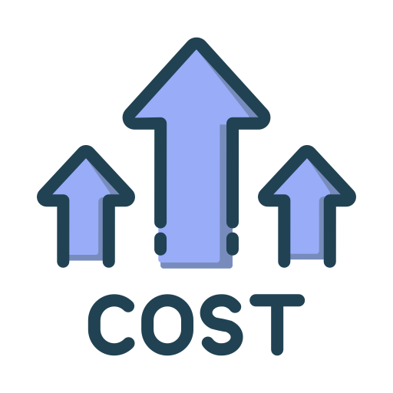
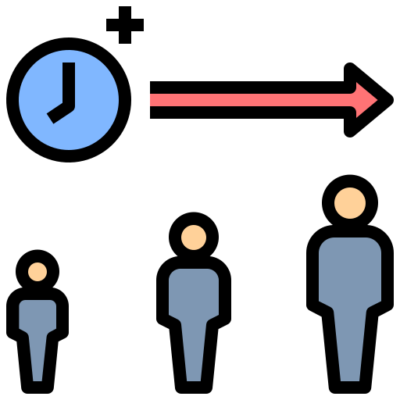

Barriers to CVD treatment
Shi Zhen
Individual
+
Healthcare
Effects on CVD outcomes
Perceived high check up costs
Missed opportunities to prevent CVD
Fear of receiving a diagnosis
Increased treatment costs
Lengthy waiting times for diagnostic tests
Worse health outcomes
Notes:
The answer lies in the barriers to effective treatment and management of the disease.
On the individual level, there's a significant reluctance to seek out regular checkups and screenings. This reluctance stems from various factors, including the perceived high costs of healthcare, fear of receiving a diagnosis, and general apprehension about the possible outcomes. Furthermore, on the healthcare level, diagnosis is often hindered by lengthy waiting times for diagnostic tests.
Such hesitancy further delays the detection of CVD, resulting in missed opportunity to detect and prevent CVD.
Thus, allowing the disease to progress unchecked and ultimately leading to higher costs for treatment and worse health outcomes.

Slide 6

Business Problem & Opportunity
accuracy rate
Shi Zhen
Opportunity
Lack of strategies for early detection of CVD
Create comprehensive predictive model to detect CVD
By utilizing analytical tools,
successful forecasts of chronic illnesses can reach up to
82%
Notes:
The overarching problem lies in the lack of effective strategies for early detection and prevention of CVD, exacerbated by patient reluctance and constraints within the healthcare system. This gap serves as an opportunity for our company, National Health Centre Singapore to overcome these challenges by harnessing the power of analytics to develop a comprehensive predictive model for CVD.
Research conducted in collaboration with Boston-area hospitals, shows that predictive models have been successful in forecasting chronic illnesses such as heart disease with an accuracy rate of up to 82%.

Slide 7

Business Problem & Opportunity
Shi Zhen
Gain insights on patient demographics, risk factors that may indicate risk of CVD
Leverage on Data Analytics
Facilitate targeted preventive interventions
Enhance operational efficiency and cost-effectiveness for healthcare and individuals
Notes:
Our company has a prime opportunity to enhance its operational efficiency and cost-effectiveness by leveraging on data analytics.
Our company can gain valuable insights of patient demographics, risk factors that may indicate risk of CVD, facilitating more targeted preventive interventions and optimising resource allocation to improve overall operational efficiency.
Moreover, analytics has shown promise in significantly reducing unnecessary hospitalizations, thereby cutting costs and improving healthcare outcomes.

Slide 8







Project HeartBeat
Shi Zhen
Objectives
Benefits
Predictive tool that relies on non-medical data
No need to wait and queue in hospitals
Free & easily accessible for everyone
Removes financial barriers
Empowers individuals to be proactive towards their cardiovascular health
Reduce overall CVD mortality rates through early prevention
Notes:
Our project, project HeartBeat is to develop a predictive model for CVD based on non-medical data. By leveraging these factors, our objectives is to create a tool that can generate a CVD risk prediction that is free and easily accessible by anyone, enabling individuals to proactively manage their cardiovascular health.
By adopting this model, we achieve several key benefits:
Elimination of lengthy waits for diagnostic tests.
Removal of financial obstacles associated with check-ups.
Enhancement of early detection and prevention efforts for heart disease, help to reduce CVD mortality rates and help to save lives

Slide 9
02
Data Sourcing & Exploration
Joleen

Slide 10

Data Sourcing
2022 Behavioural Risk Factor Surveillance System Survey Data (CDC)
Joleen
Factors related to CVD
Personal Particulars
Physical Characteristics
General Health Status
Health Habits & Behaviours
Health Issues & Illness History
Categorized into

Slide 11
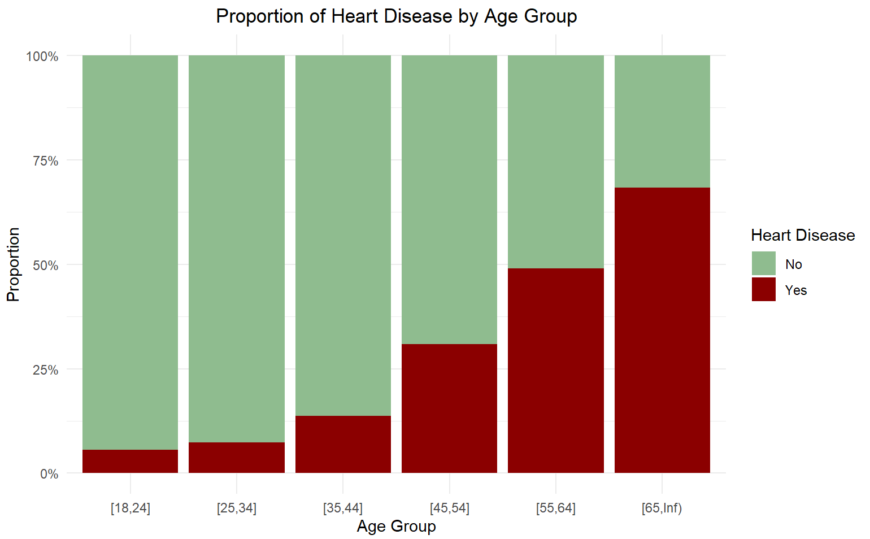
Heart Disease by Personal Factors
Age is a significant risk factor that compromises on cardiovascular system
Myriad physiological changes such as increased oxidative stress
Joleen
Data Exploration

Slide 12
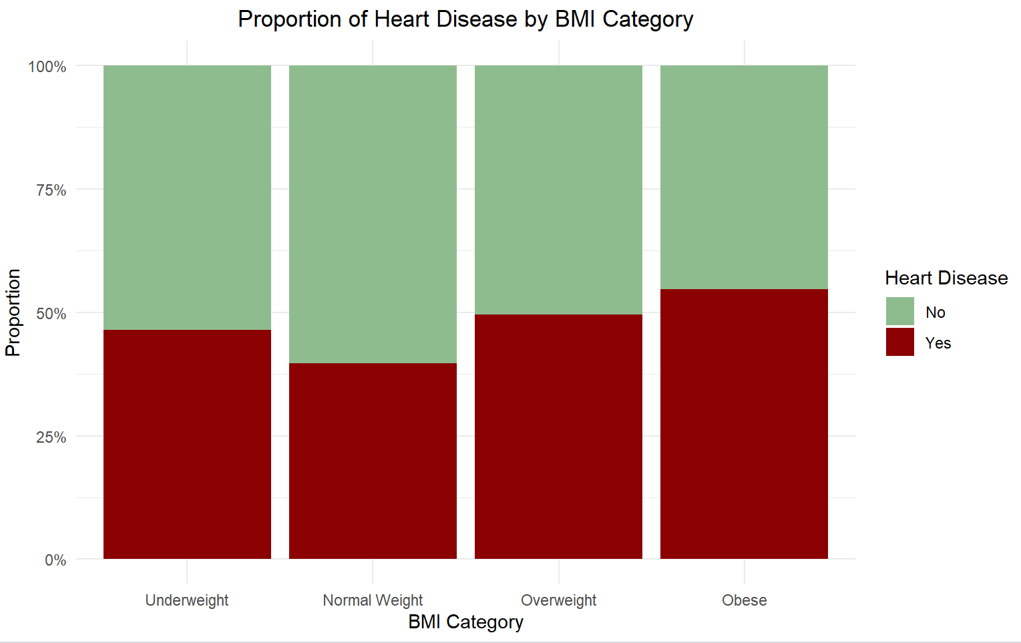
Heart Disease by Physical Characteristics
Obesity contributes to various physiological mechanisms
Haemoglobin deficiency is more prevalent among underweight individuals
Joleen
Data Exploration

Slide 13
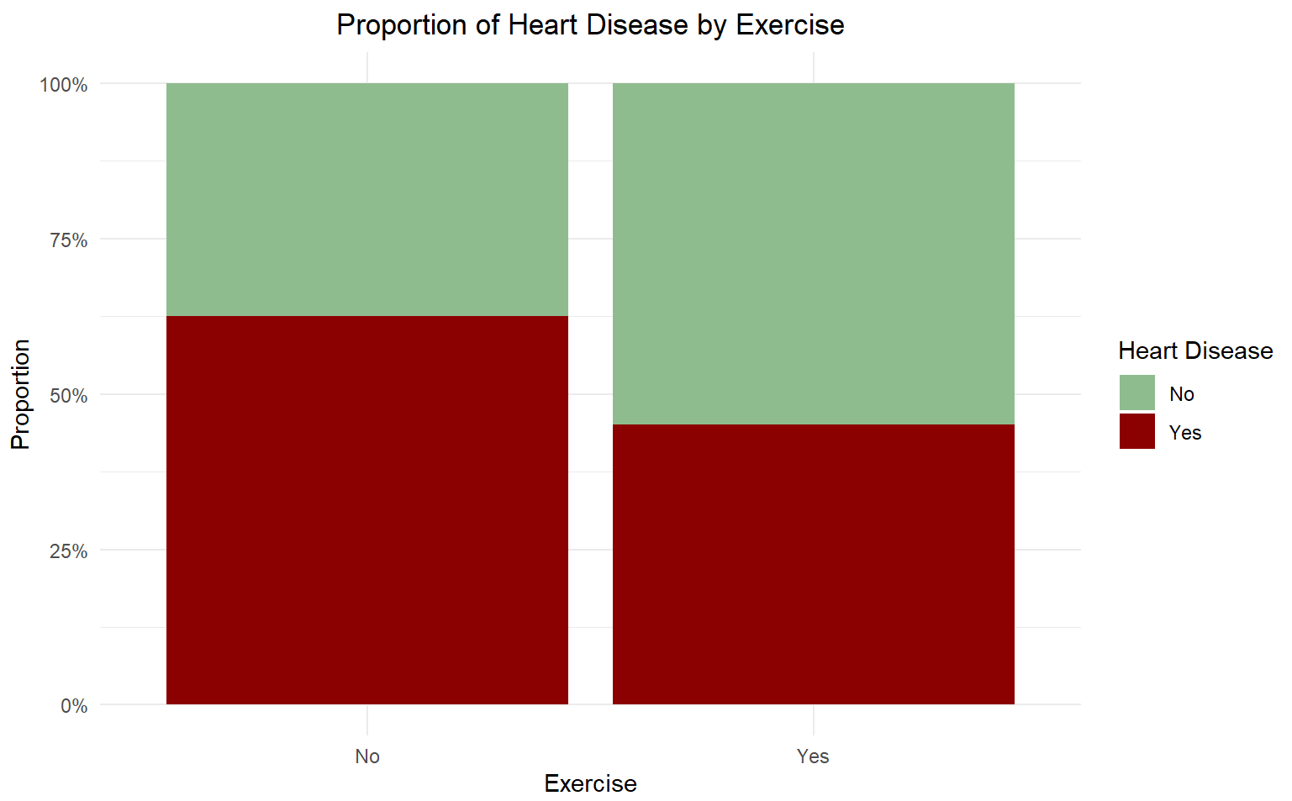
Heart Disease by Health Habits & Behaviours
Physical inactivity can lead to other risk factors of heart disease such as diabetes, obesity etc.
Joleen
Data Exploration

Slide 14
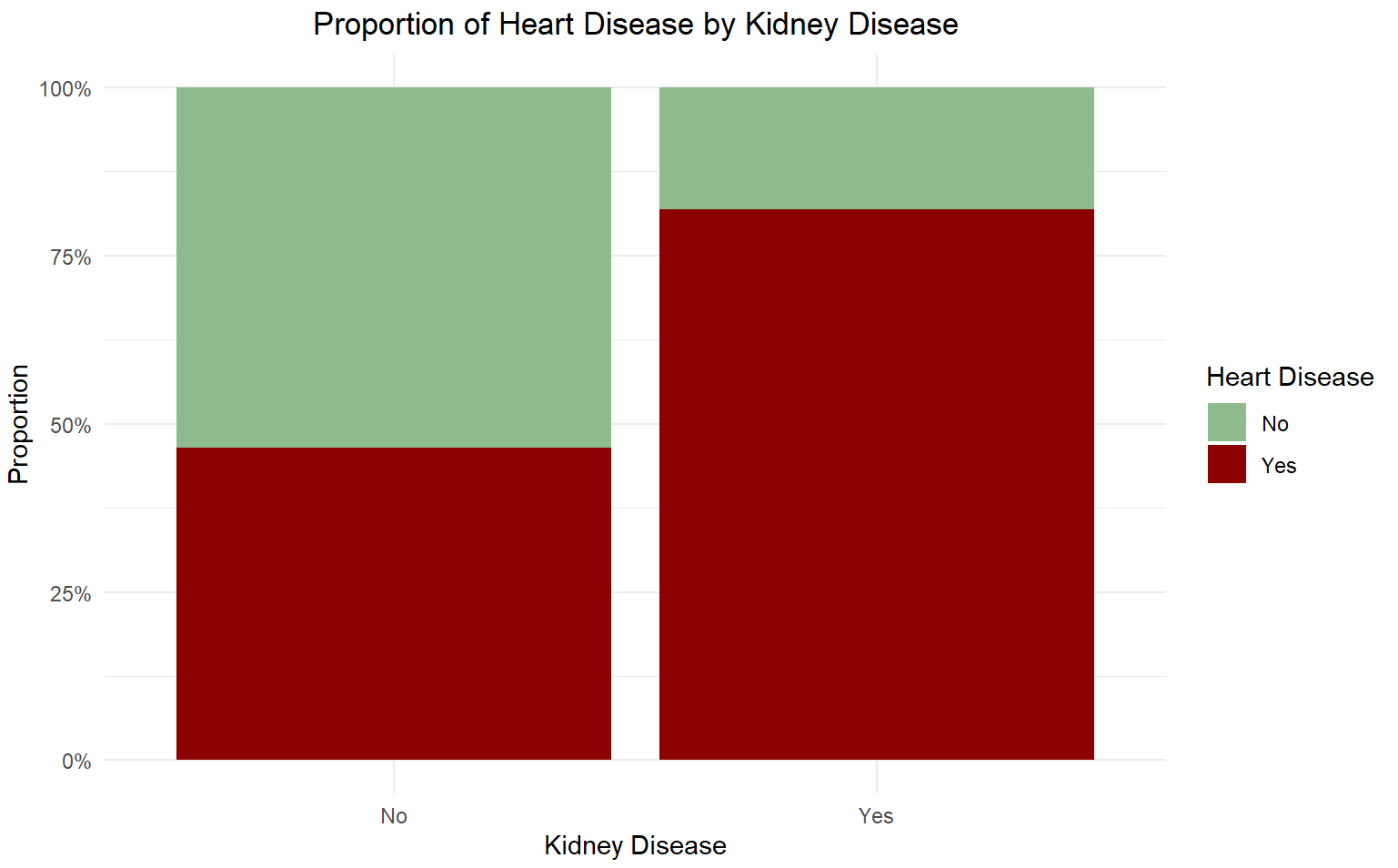
Heart Disease by Heart Issues & Illness History
Strain placed on the heart due to kidney dysfunction
More effort required to circulate blood to kidney
Presence of high blood pressure exacerbates the strain
Joleen
Data Exploration

Slide 15
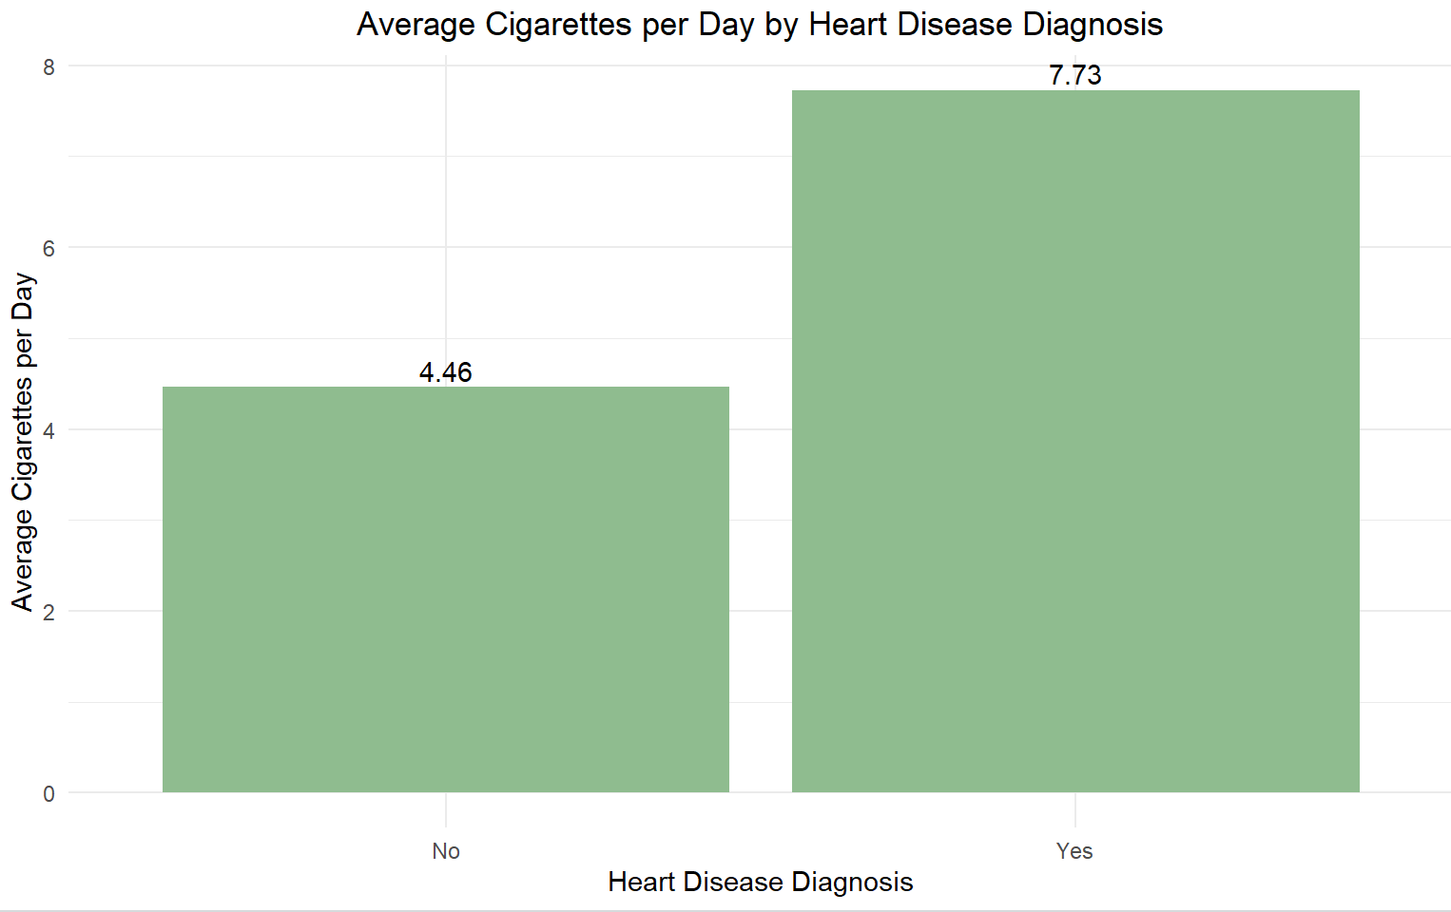
Average Cigarettes Per Day
Compounds present in cigarette promote the accumulation of plaque in blood vessels
Elevate heart rate and induce inflammation
Joleen
Data Exploration

Slide 16
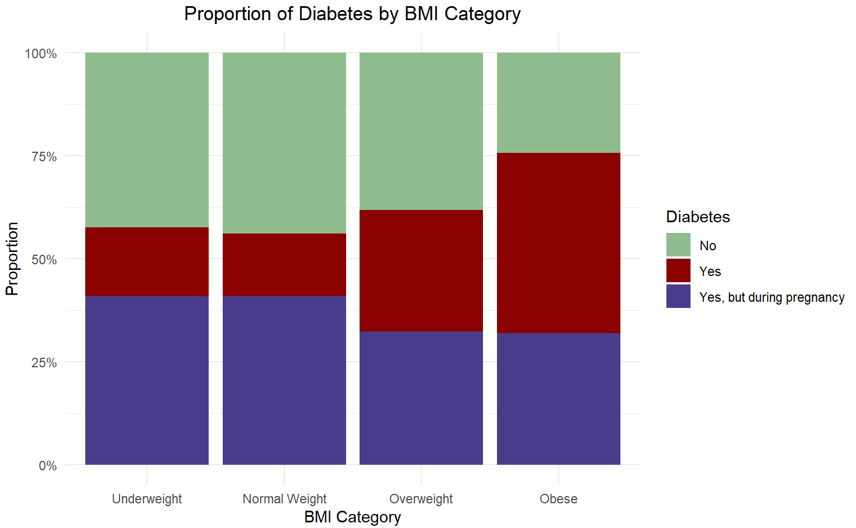
Diabetes by BMI Category
Excessive body fat accumulation is a key contributor to type 2 diabetes
Joleen
Data Exploration

Slide 17
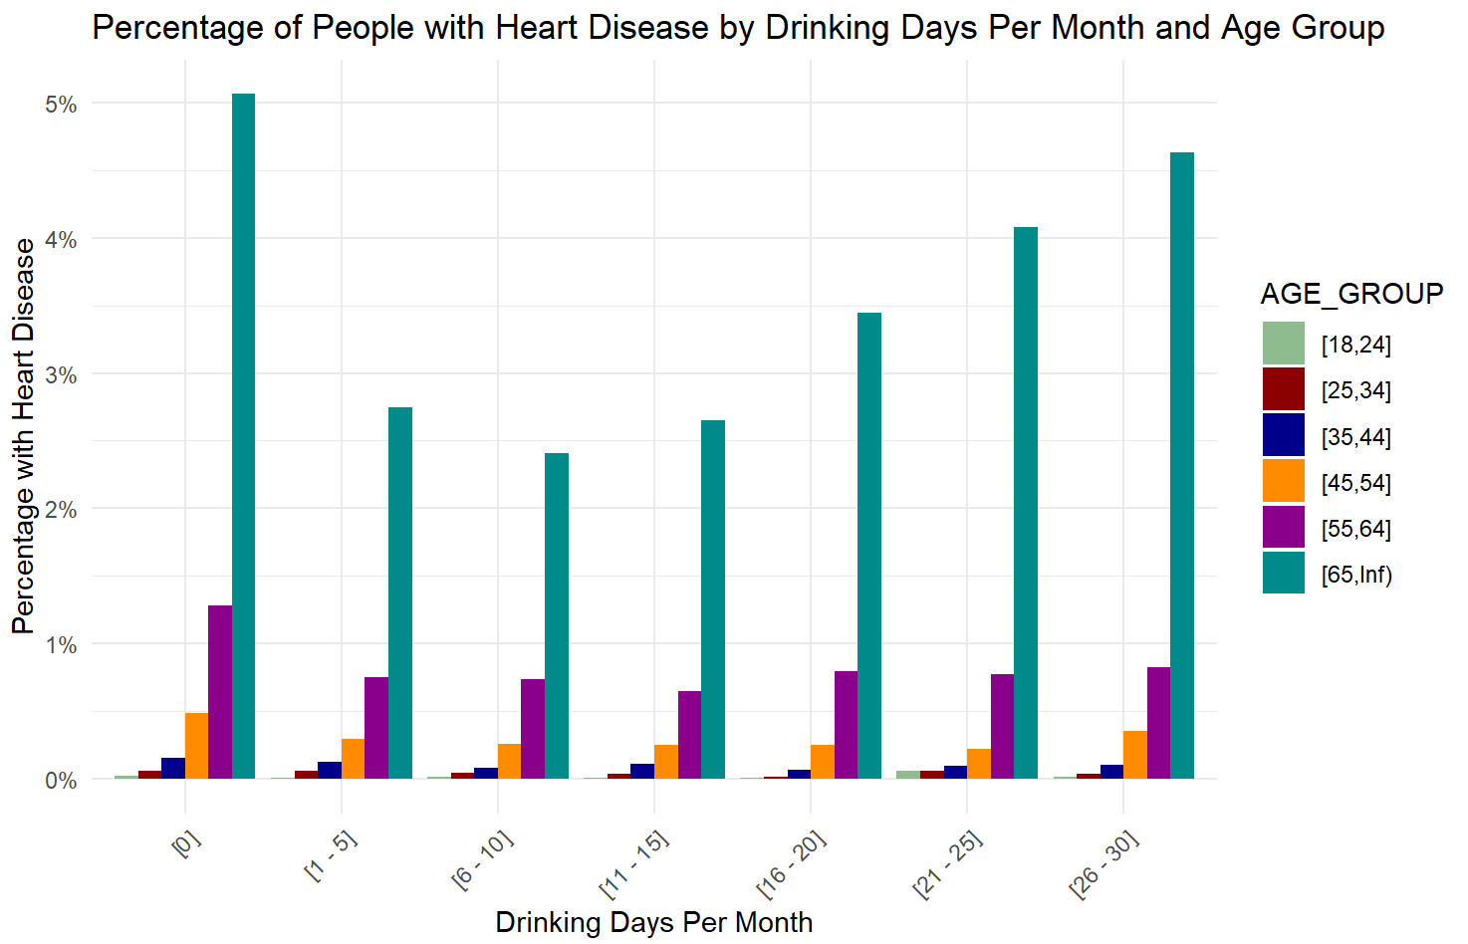
Heart Disease by Drinking Days Per Month
and Age Group
Excessive alcohol consumption can increase risk of high blood pressure
Dependent on the frequency and amount of alcohol consumed
Joleen
Data Exploration

Slide 18
03
MODELS
Lee Tin

Slide 19
Models Developed
Lee Tin
Dataset
Trainset
Logistic Regression
Testset
CART
Random Forest
Neural Network

Slide 20
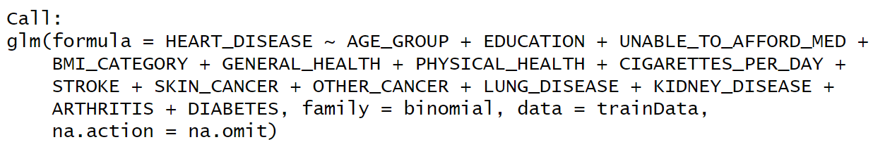
Logistic Regression
Lee Tin
Model built based on insights derived from EDA
Backward stepwise selection was employed
Checked for multicollinearity
Variables with high p-values removed, due to lack of statistically significant impact on the target variable, resulting in the optimal logistic regression model

Slide 21
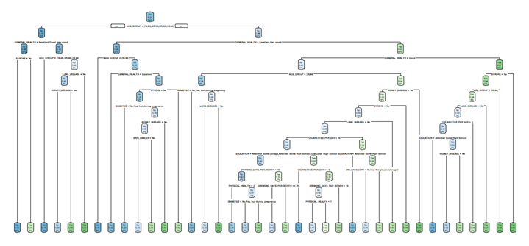
CART - Classification Tree
Lee Tin
Optimal Prune
Optimal complexity parameter determined based on cross-validation results
Tree is pruned using this optimal CP of 0.00118497 to 38 terminal nodes

Slide 22
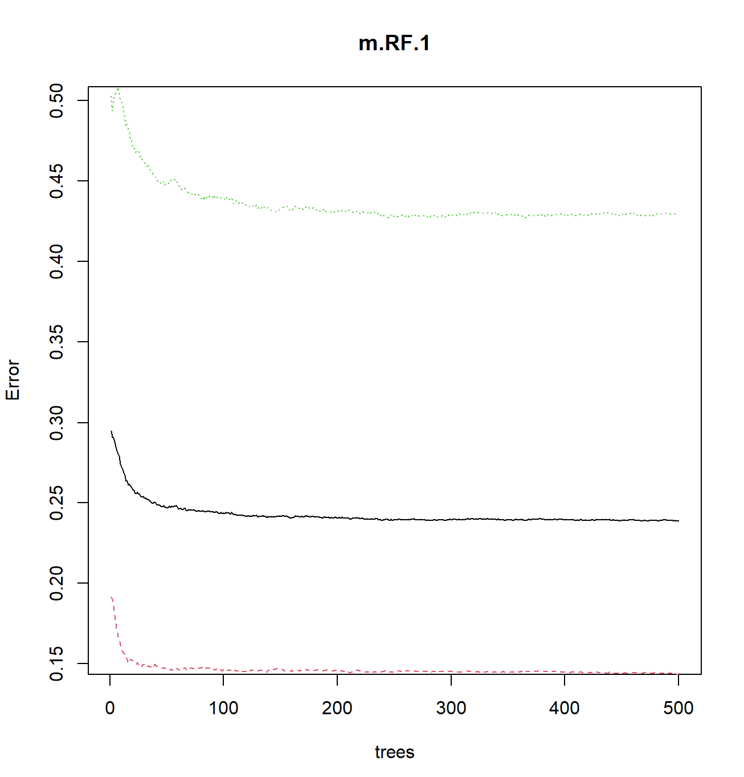
Random Forest
Lee Tin
OOB Error against Number of Trees
Model Evaluation
Optimal model determined by minimising and stabilising the Out-of-bag (OOB) error
Stabilized after 100 to 150 trees
OOB error 23.92%

Slide 23
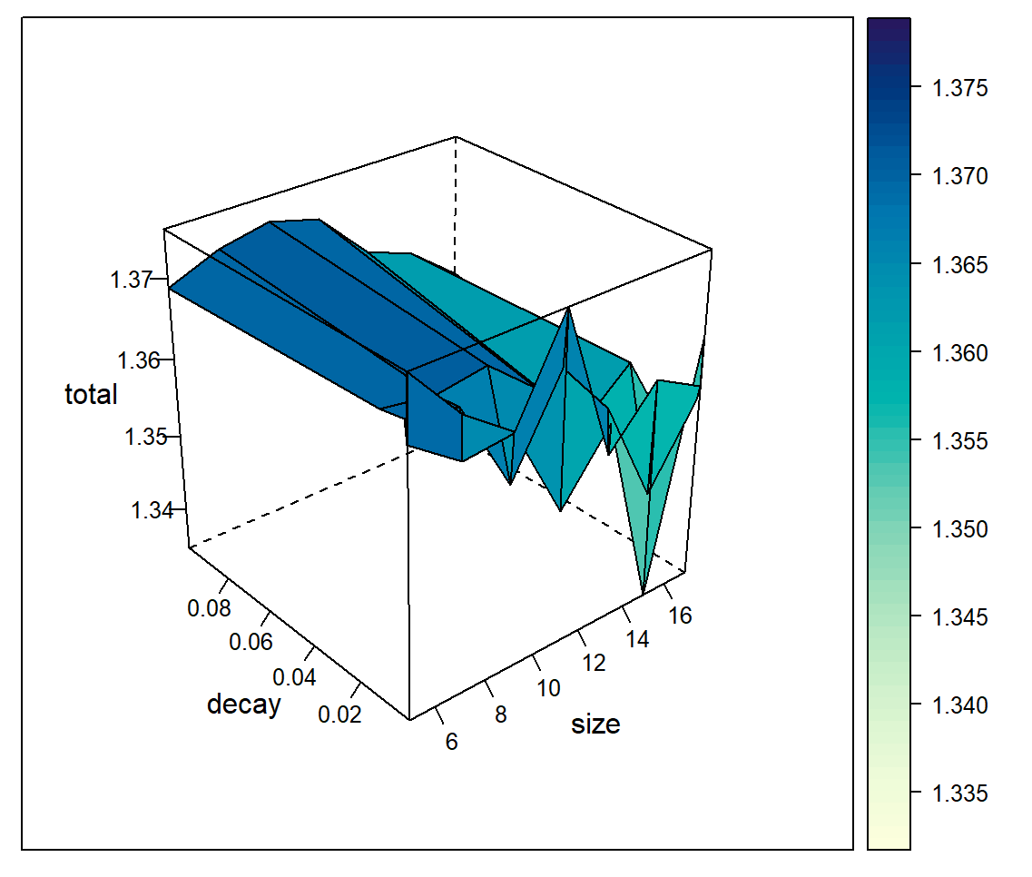
Neural Network
Lee Tin
Model Evaluation
Through grid search, the optimal size of 17 nodes and weight decay of 1e-05, gives the best model accuracy and the optimal Neural Network model

Slide 24
Confusion Matrix Results
Lee Tin
Logistic Regression |  | Predicted
 |  | No | Yes
Actual | No | TN 8345 | FP 2837
 | Yes | FN 1319 | TP 4282
CART |  | Predicted
 |  | No | Yes
Actual | No | TN 9524 | FP 1678
 | Yes | FN 2261 | TP 3340
Random Forest |  | Predicted
 |  | No | Yes
Actual | No | TN 22254 | FP 3882
 | Yes | FN 5742 | TP 7326
Neural Network |  | Predicted
 |  | No | Yes
Actual | No | TN 10823 | FP 379
 | Yes | FN 4168 | TP 1433

Slide 25
Model Employed
Lee Tin
Models | TPR (%) | FNR (%) | FPR (%) | TNR (%) | Accuracy (%)
Logistic Regression | 76.5 | 23.5 | 25.3 | 74.7 | 75.3
CART | 59.6 | 40.4 | 15.0 | 85.0 | 76.6
Random Forest | 56.1 | 43.9 | 14.9 | 85.1 | 75.5
Neural Network | 25.6 | 74.4 | 3.4 | 96.6 | 72.9
Final Decision
Logistic regression model has been selected as the most optimal model
All 4 models have similar accuracy
Logistic regression has the highest TPR of 76.5%

Slide 26
Business Insights from Models
Lee Tin
VARIABLE IMPORTANCE
Insights
Variable | Importance
AGE_GROUP [above 65] | 18.815
GENERAL HEALTH [fair & poor] | 26.030 25.663
STROKE | 18.665
These variables appear to have notable impacts on the likelihood of developing CVD
Understanding the importance of these variables can enable more targeted and effective preventive strategies

Slide 27
Business Insights from Models
Lee Tin
ODDS RATIO FOR
LOGISTIC REGRESSION
Insights
Variable | Odds Ratio
AGE_GROUP [above 65] | 14.729
GENERAL HEALTH [poor] | 7.600
STROKE | 2.453
Higher odds ratio:
1) in AGE_GROUP for individual aged above 65
2) poor GENERAL_HEALTH
3) for individual with stroke
signifies a heightened risk of CVD
Prioritize interventions aimed at improving these variables can help with resource allocation and reduce the risk of CVD, ultimately improve patient outcomes and cost efficiency

Slide 28
Sally
04
NHCS’ Current Measures

Slide 29





Current Reactive Measures
Sally
Supplemented with
Cardiac Tests
AI Tool
Echocardiogram (ECG),
Cardiac Computed Tomography (CT) Scan,
Exercise Stress Test (Treadmill Exercise) and more
Gabor-Convolutional Neural Network (Gabor-CNN) algorithm
Recognise ECG patterns to diagnose CVD
98.5% Accuracy

Slide 30



Limitations
Sally
Limited Improvement in Efficiency and Cost
AI tool still requires ECG to be conducted
Costly and time-consuming
Lack of Early Prevention Measures
Current focus on reactive measures
Potential delayed diagnosis for those at risk only when they show CVD symptoms
Limited Predictive Variables
AI tool only analyses ECG signals
Non-medical factors also play a part in determining risk

Slide 31
05
Proposed Solution
Sally

Slide 32
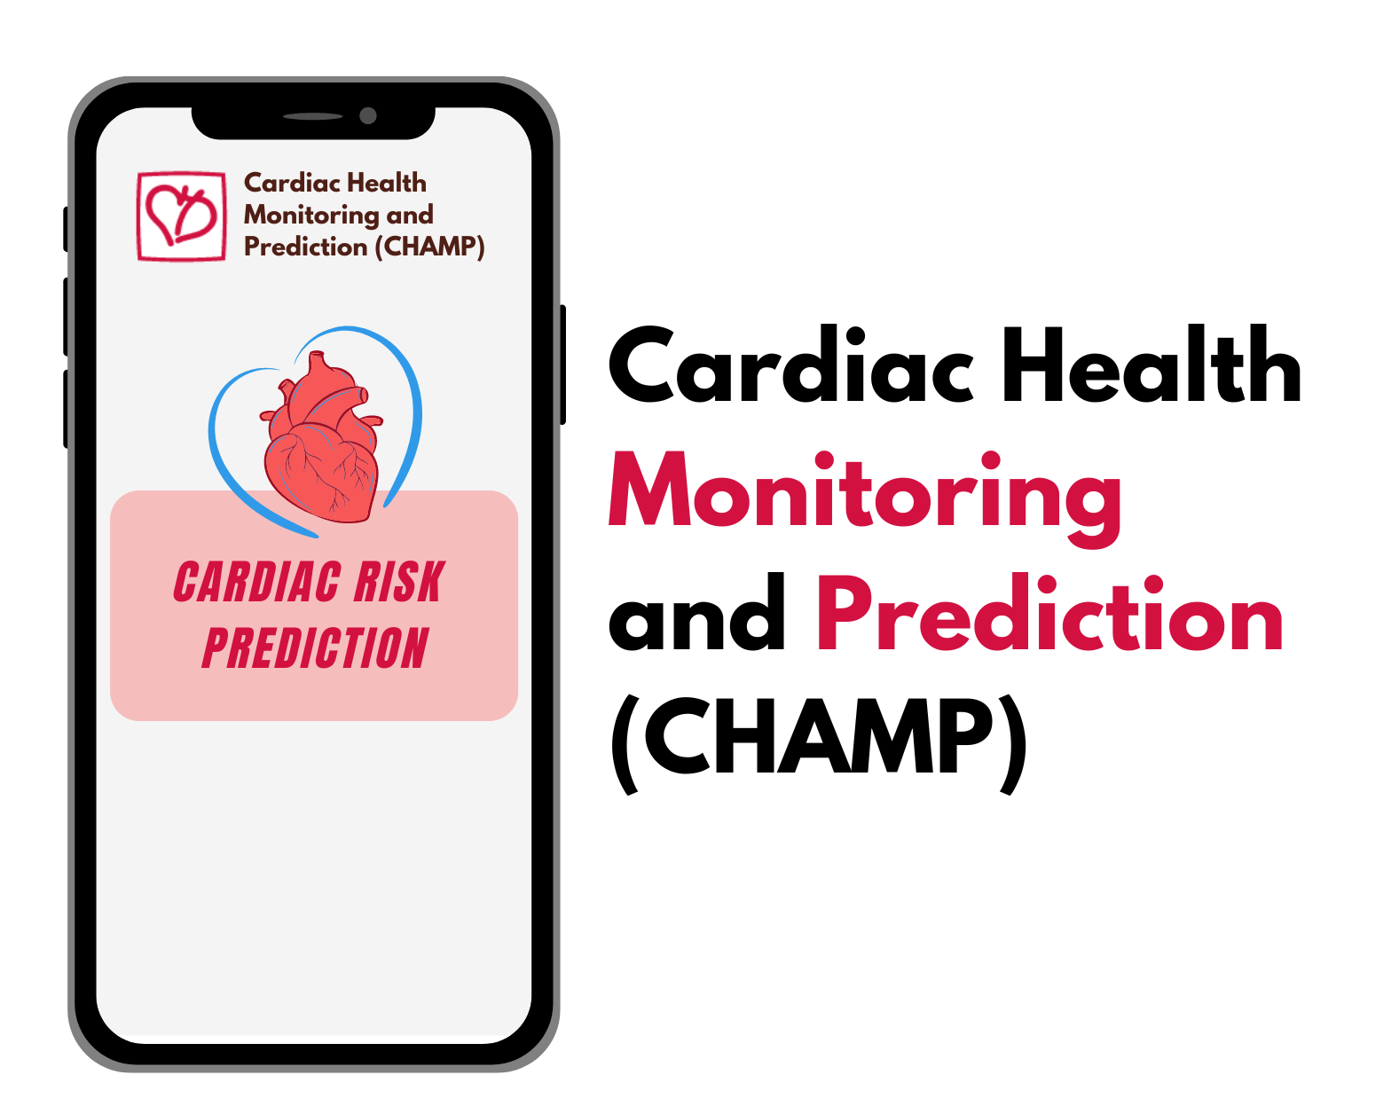

Proposed Solution
Sally
Current Measures
Reactive
Supplemented with
Predictive
Our Solution
Preventive

Slide 33



Overview of CHAMP App: 3Ps
Sally
Predictive Analytics Models
Personalised Preventive Measures
Public Education
Notes:
Empowers early intervention using predictive analytics models
Personalised preventive measures
Enhances public education

Slide 34
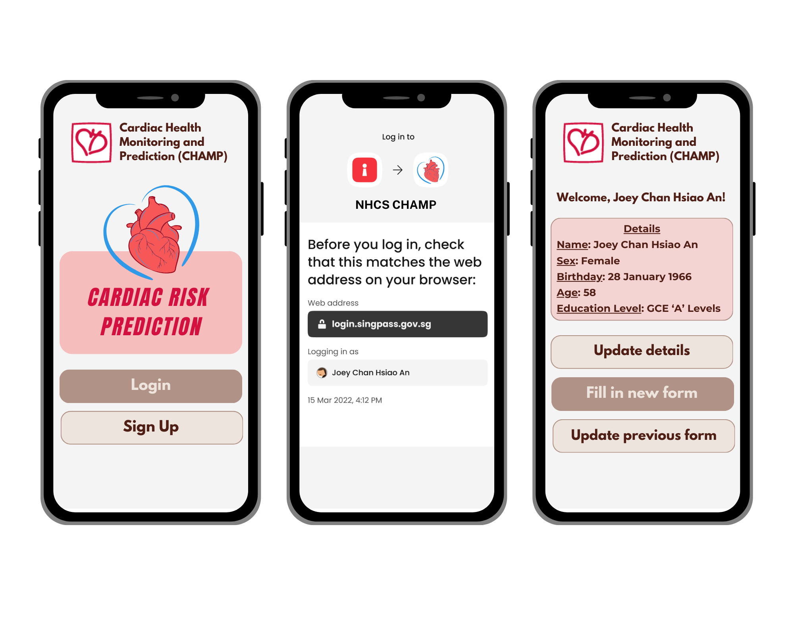
Predictive Feature 1: Retrieval of Input Factors
Sally
Automatic Retrieval of Details & Form History
Biometric Login

Slide 35
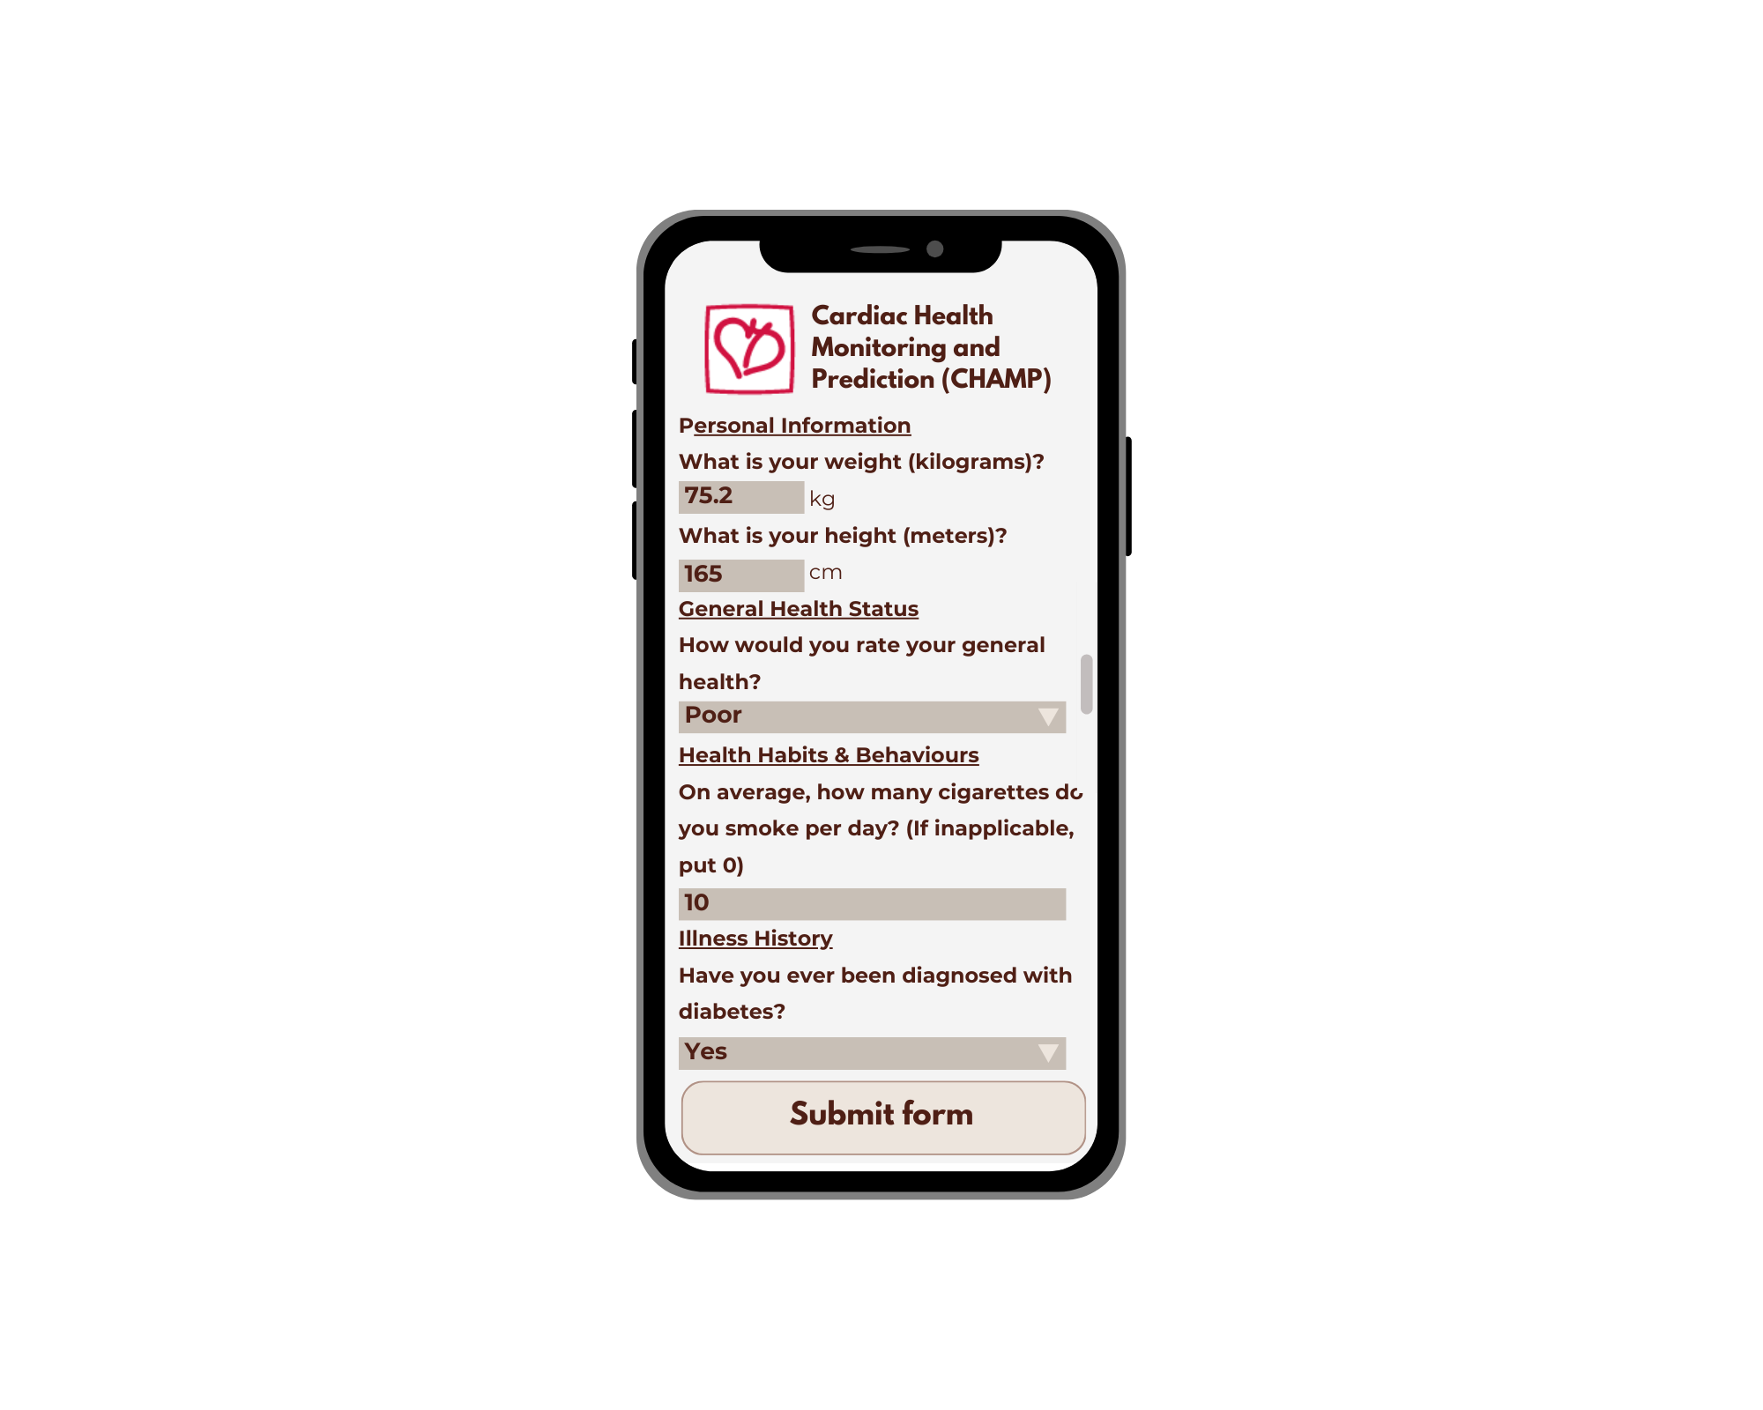
Predictive Feature 2: Risk Assessment Form
Sally
Continuous Variables
Fill in numerical value
Categorical Variables
Select category from dropdown

Slide 36
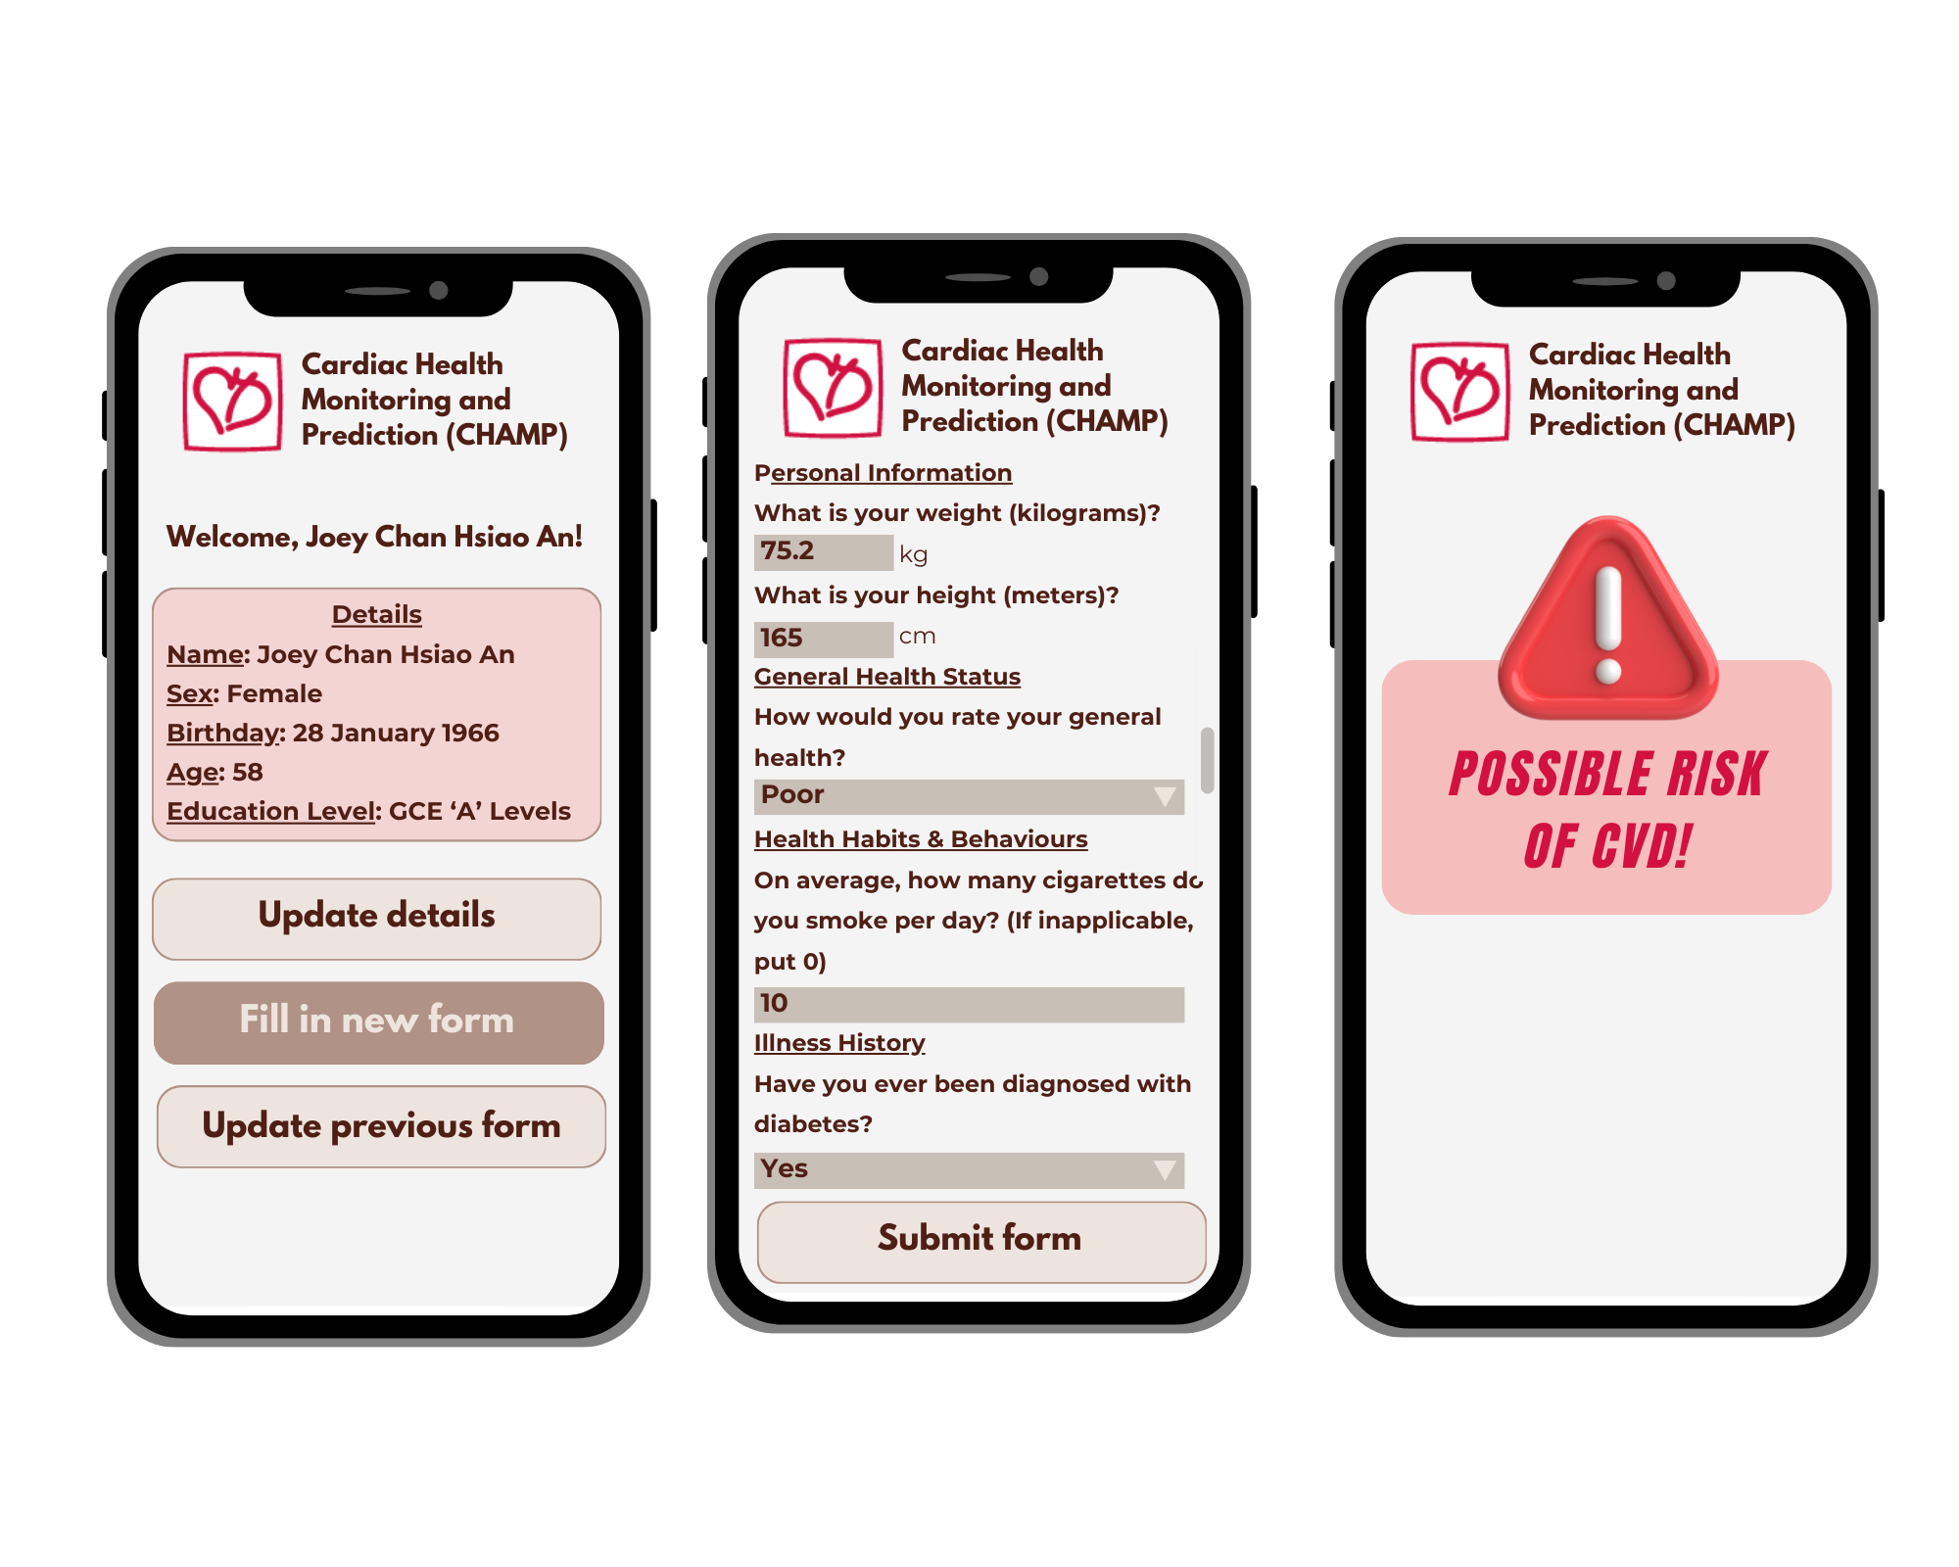
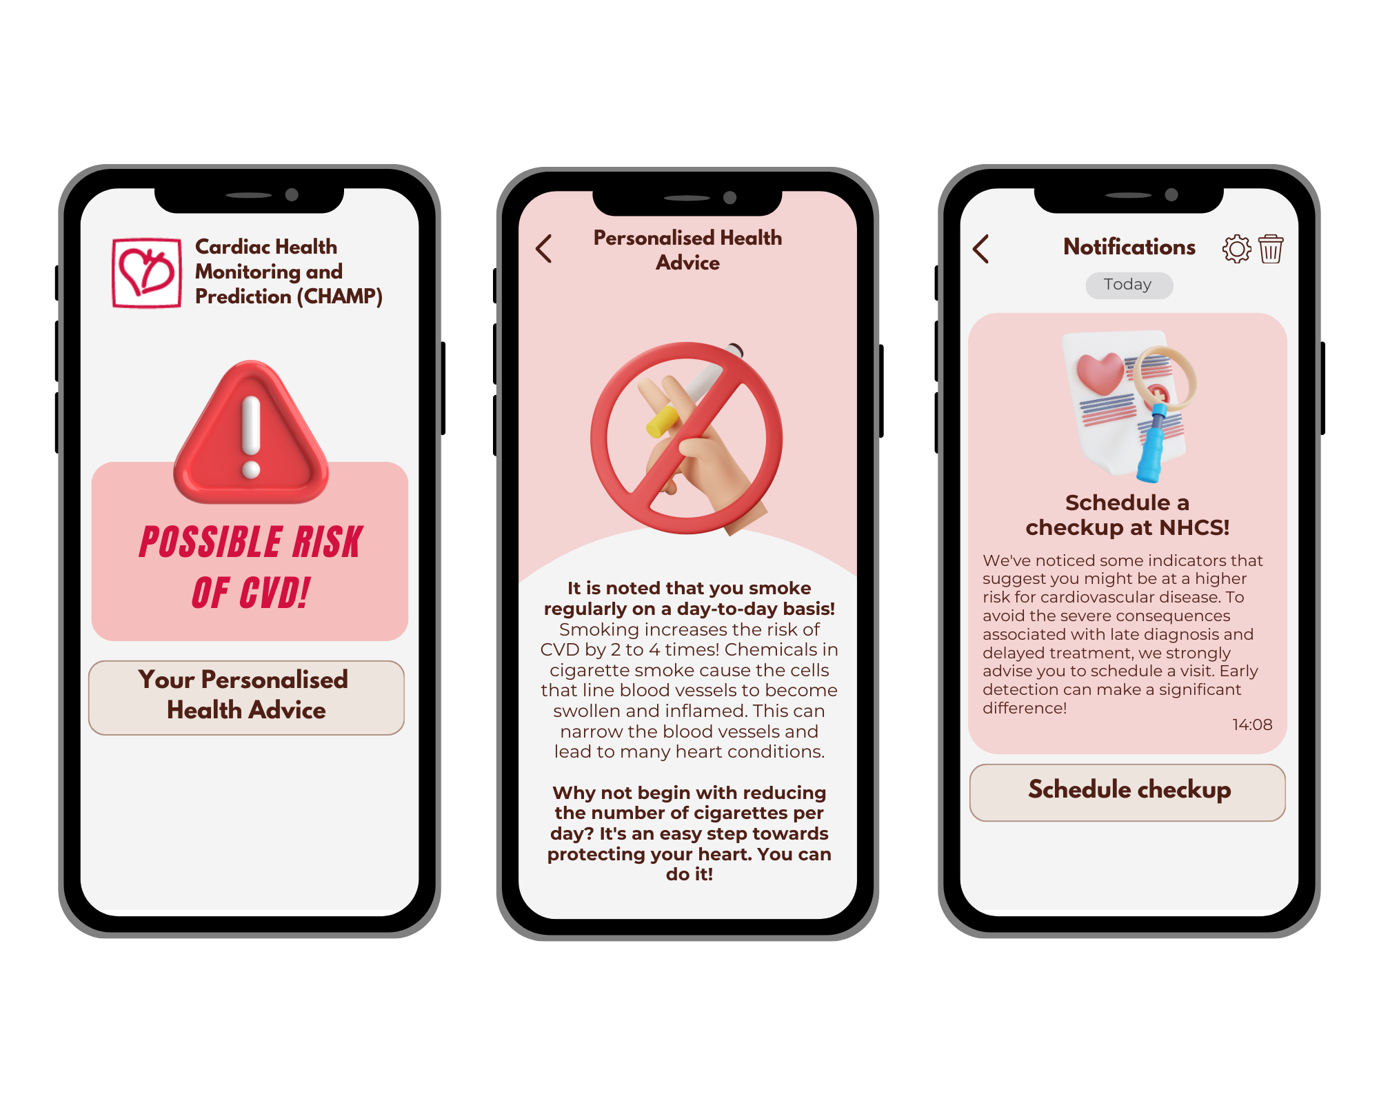
Predictive Feature 3: Utilisation of Logistic Regression Model
Sally
Running our Logistic Regression Model…
Results generated
At risk for CVD: Yes
Probability: 0.805

Slide 37
Preventive Features: At risk for CVD
Sally
1. Personalised Health Advice
2. Scheduled Check-up Notifications

Slide 38
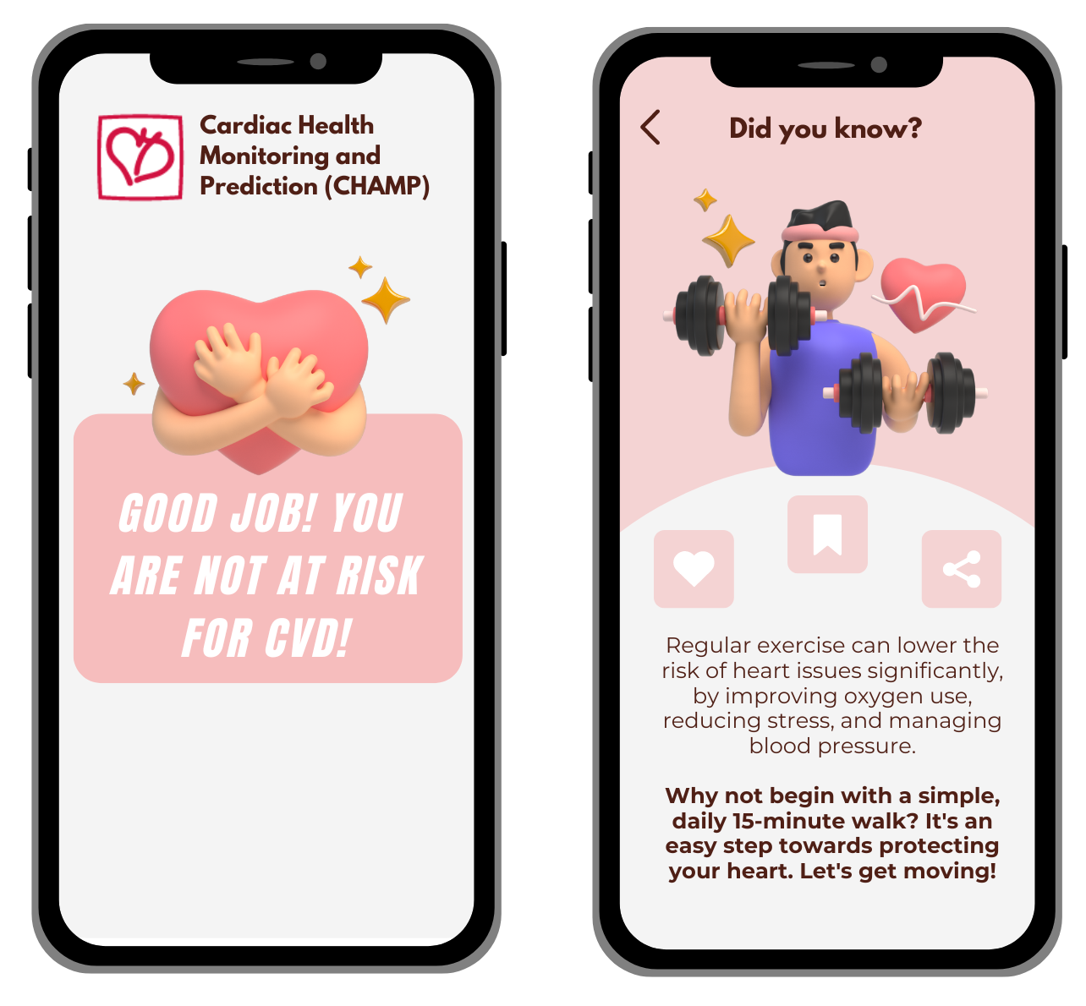
Preventive Features: Not at risk
Sally
Educational information about CVD
Raise awareness even if they are not at risk

Slide 39
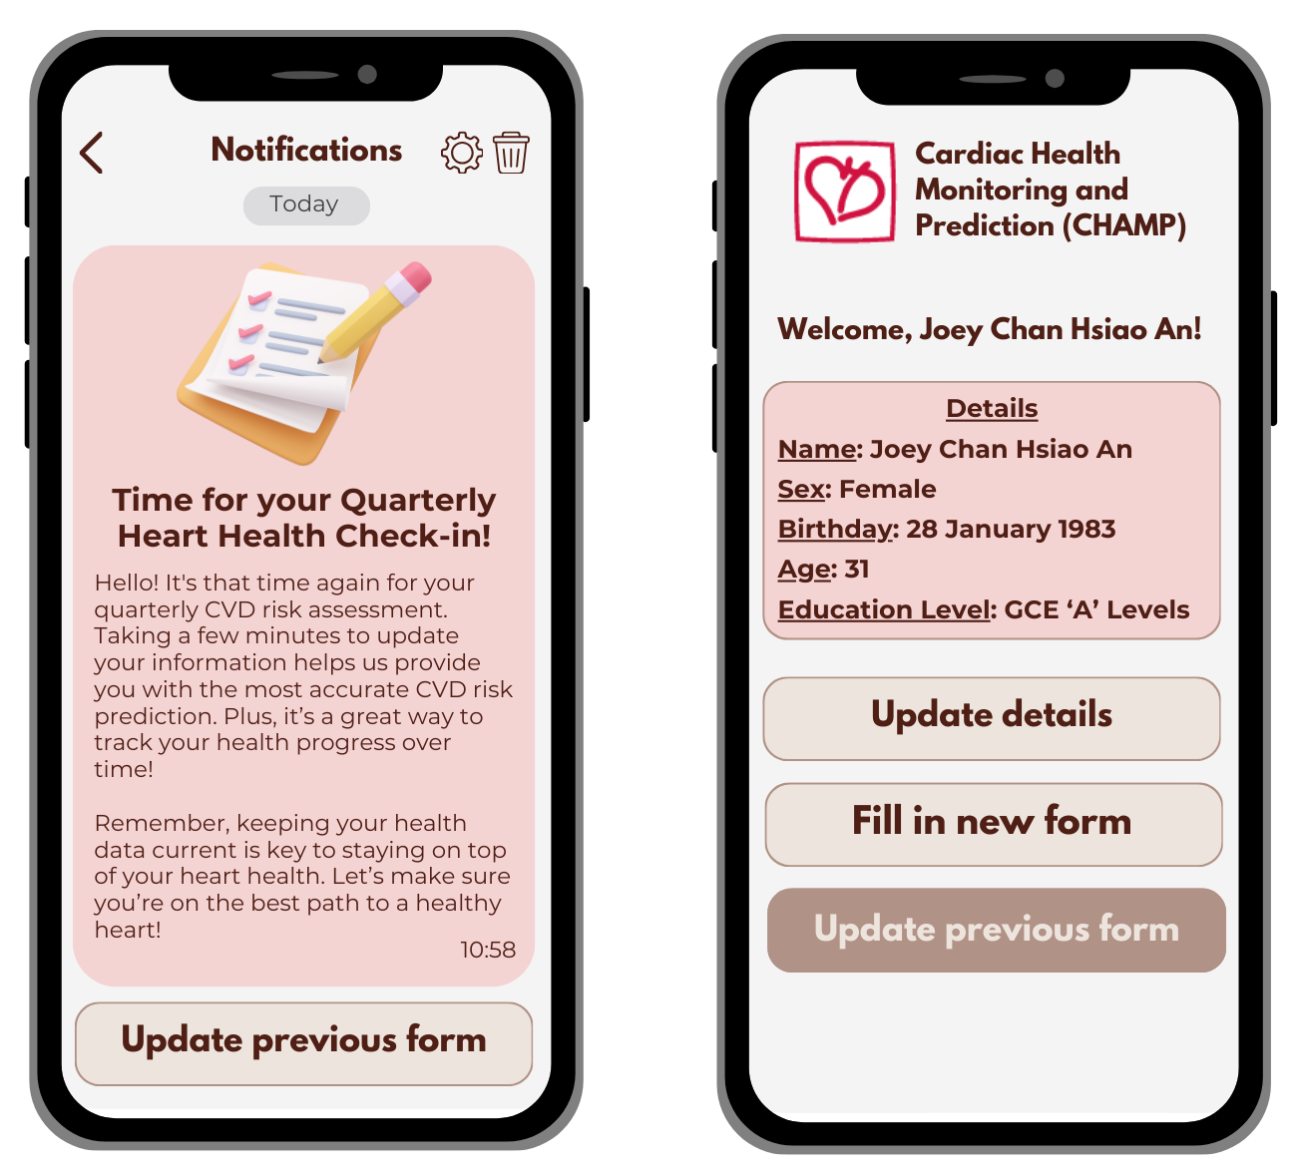
Preventive Features: For everyone
Sally
Quarterly reminders to update Risk Assessment Form
Continuous monitoring to track improvements
Dynamic adjustments in health advice

Slide 40
Review of CHAMP App
Sally
Predictive Analytics Models
Personalised Preventive Measures
Public Education

Slide 41





Value Proposition
Tenia
User-Friendly Interface
Simplified Registration
Freely Available
Preventive Approach
Risk Prediction
Lifestyle Integration
Notes:
Thank you sally. Going through our CHAMP’s value proposition.
User-Friendly Interface: Designed for all age groups, CHAMP app ensures ease of use and accessibility.
Simplified Registration: Integration with SingPass streamlines registration, enhancing accessibility.
Freely Available: CHAMP is freely available on various app stores, ensuring widespread accessibility without financial barriers.
Preventive Approach: CHAMP utilised predictive analytics to offer data-driven preventive measures, distinguishing from traditional reactive methods.
Risk Prediction: CHAMP predicts individuals at risk, enabling early diagnosis of CVD and reducing the need for advanced stage treatments.
Lifestyle Integration: CHAMP integrates lifestyle and behavioral factors in risk management, empowering individuals to make informed decisions and reducing demand on NHCS' resources.
Overall, CHAMP aligns greatly with NHCS' goal of improving efficiency.

Slide 42





Feasibility
Tenia
Eliminate financial barriers for users
Facilitates early detection of CVD
Initial Investment
Financial Empowerment
Long-Term Cost Saving
Software Development and Singpass integration
Free Accessibility
Enabling proactive preventive measures without cost burdens.
Early Detection
Long-term benefits outweigh short-term costs
Notes:
Next up, the feasibility of CHAMP.
In the short run, CHAMP incurs initial investment costs for software development and integration with SingPass.
Despite initial costs, CHAMP is freely available on all app stores, eliminating financial barriers for users.
Without financial constraints, it enables individuals to take proactive preventive measures without cost burdens.
This further facilitates early detection of Cardiovascular Disease (CVD), allowing prompt check-ups and treatment, lowering CVD mortality rates.
Successful early detection reduces healthcare costs and burdens on healthcare systems, potentially saving lives.
Therefore, the long-term benefits outweigh short-term costs, making CHAMP a sustainable investment in health and healthcare efficiency.

Slide 43


Feasibility
Tenia
CVD Mortality Rate
Cost of Treatment
Waiting Time
Indicates effectiveness in reducing Cardiovascular Disease (CVD) mortality
Assess the app's effectiveness in reducing healthcare expenses for users
Evaluate improvements in healthcare accessibility facilitated by CHAMP
Notes:
To measure the success of CHAMP, we will track three key metrics.
Firstly, CVD mortality rate is a measure of early risk detection impact on saving lives.
Secondly, calculating the difference in average treatment costs between CHAMP users and non-users access the app’s effectiveness in reducing healthcare expenses for users.
Lastly, monitoring the changes in average waiting time for appointments helps to evaluate improvements in healthcare accessibility facilitated by the app.

Slide 44
Tenia
06
Improvements & Conclusion
Notes:
Lastly, improvements and conclusion

Slide 45
Tenia
Limitations & Improvements
 | Limitation | Improvement
Inaccurate Information | Accuracy reliant on completeness of user-provided data. | Integrate wearable devices for real-time health data and schedule periodic checkups for validation.
Subjectivity of Self-Assessment | User input introduces variability in predictions. | Provide structured prompts for classification, reducing subjectivity and improving accuracy.
Limited Comprehensiveness of Risk Factors | Current dataset lacks crucial factors like dietary habits. | Access local datasets with broader factors and utilize user data for enhanced predictive ability.
Notes:
We have identified 3 limitations.
Inaccurate information with accuracy relying on completeness of user-provided data. Improvement is to integrate wearable devices for real time health data and schedule periodic checkups for validation.
Subjectivity of self assessment where user input introduces variability in predictions due to different perceptions and understanding of their standards of health. Improvement is to provide structured prompts for classification, thereby reducing subjectivity and improving accuracy.
Limited comprehensiveness of risk factors due to lack of crucial factors like dietary habits which are significant in influencing heart health. Improvement is to access local datasets with broader factors and utilize user data for enhanced predictive ability.

Slide 46
Tenia
Conclusion
Enhance Clinical Capabilities
Optimal Patient Care
Cost-Efficiency and Sustainability
Reputable Leader in Cardiovascular Care
Notes:
In conclusion, by leveraging predictive analytics, NHCS not only enhances patient care and outcomes but also strengthens its reputation as a leader in cardiovascular care while promoting cost-efficiency and sustainability in healthcare delivery.

Slide 47
Tenia
PowerBI Demonstration

Slide 48
Thank You!
Tenia
Do you have any questions?

Slide 49
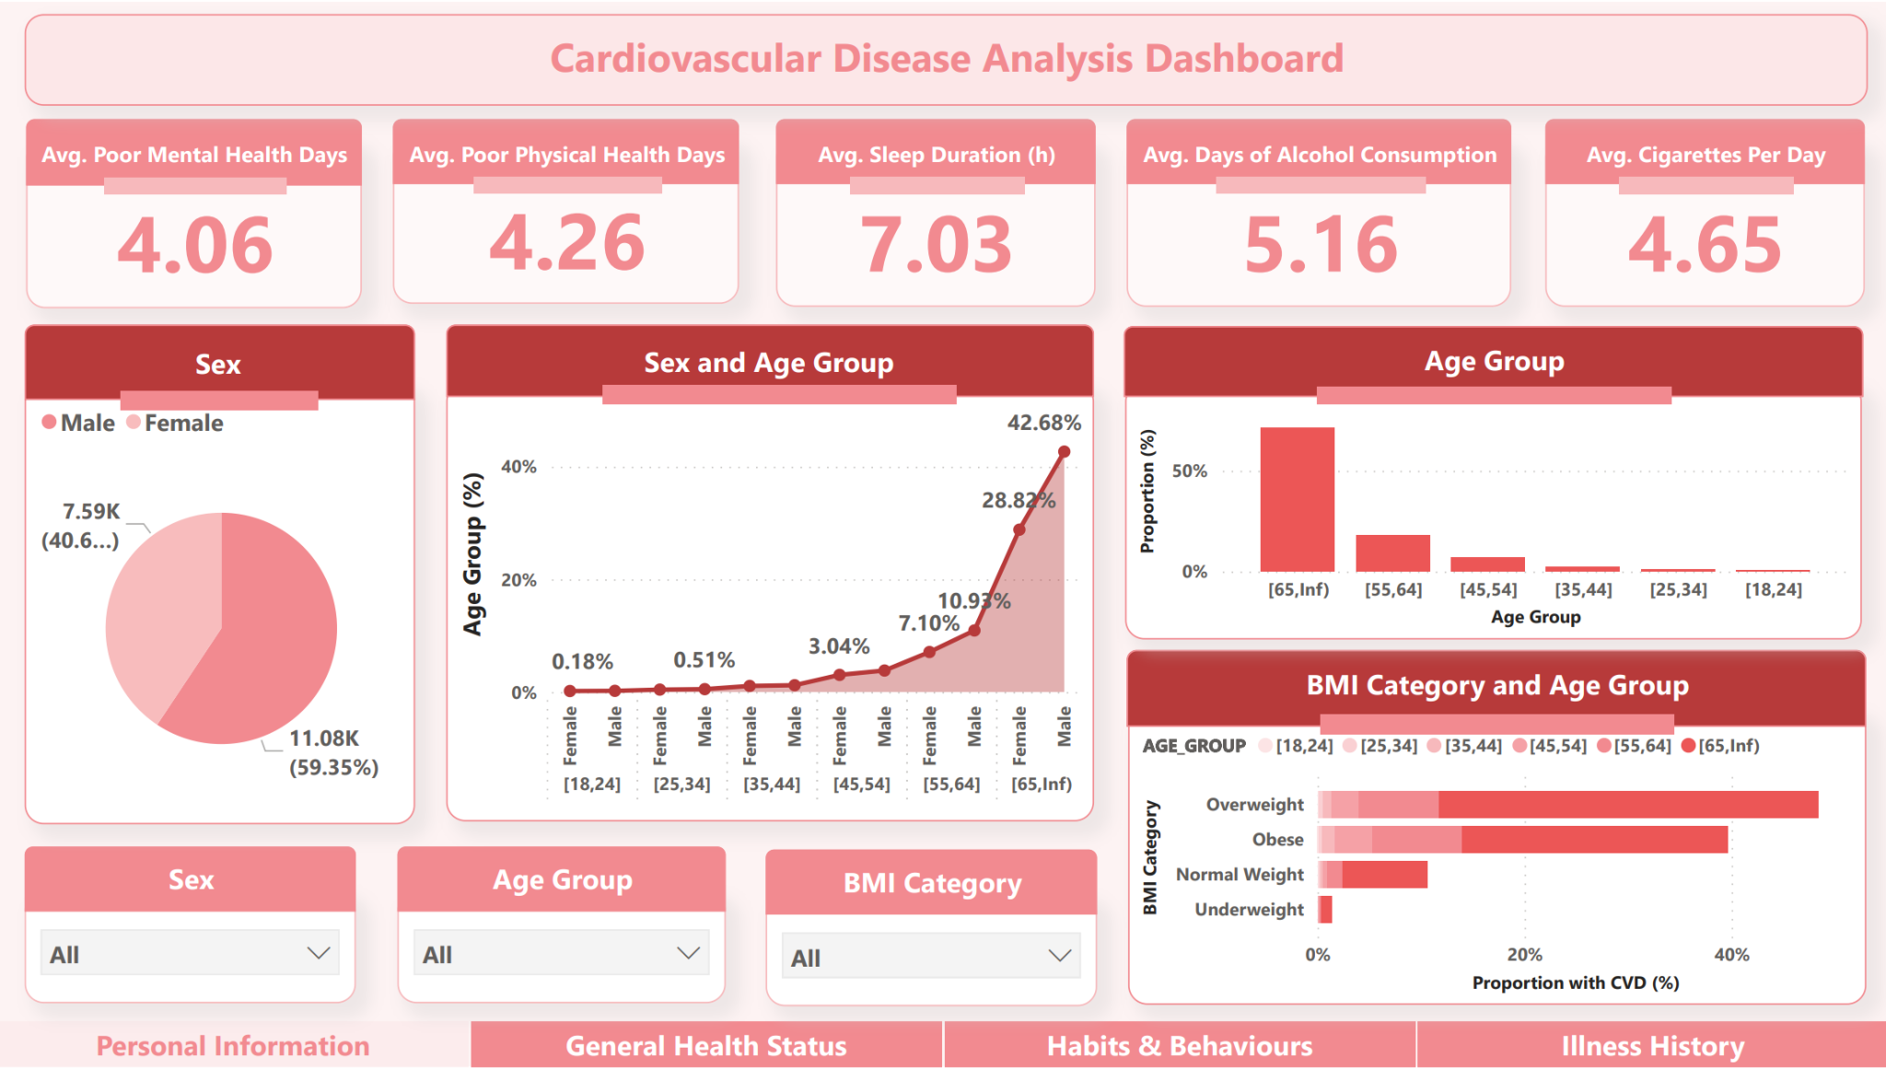
Appendix: Dashboard
Tenia

Slide 50
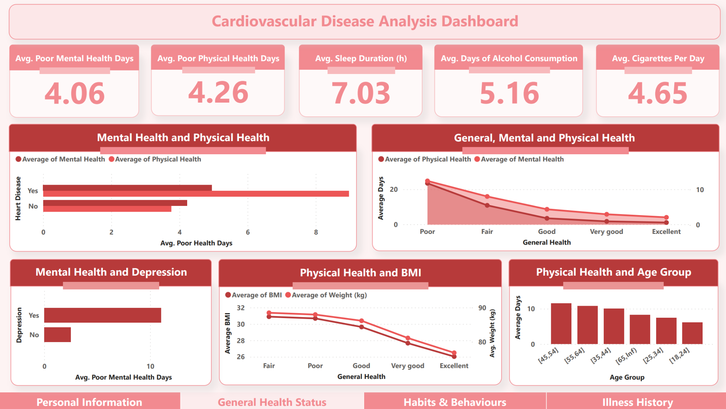
Appendix: Dashboard
Tenia

Slide 51
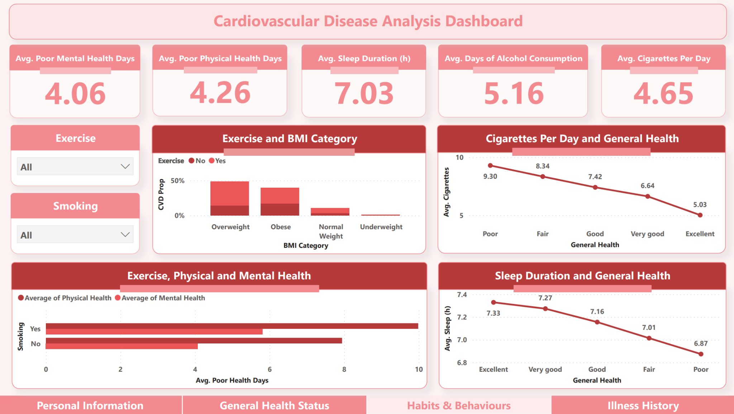
Appendix: Dashboard
Tenia

Slide 52
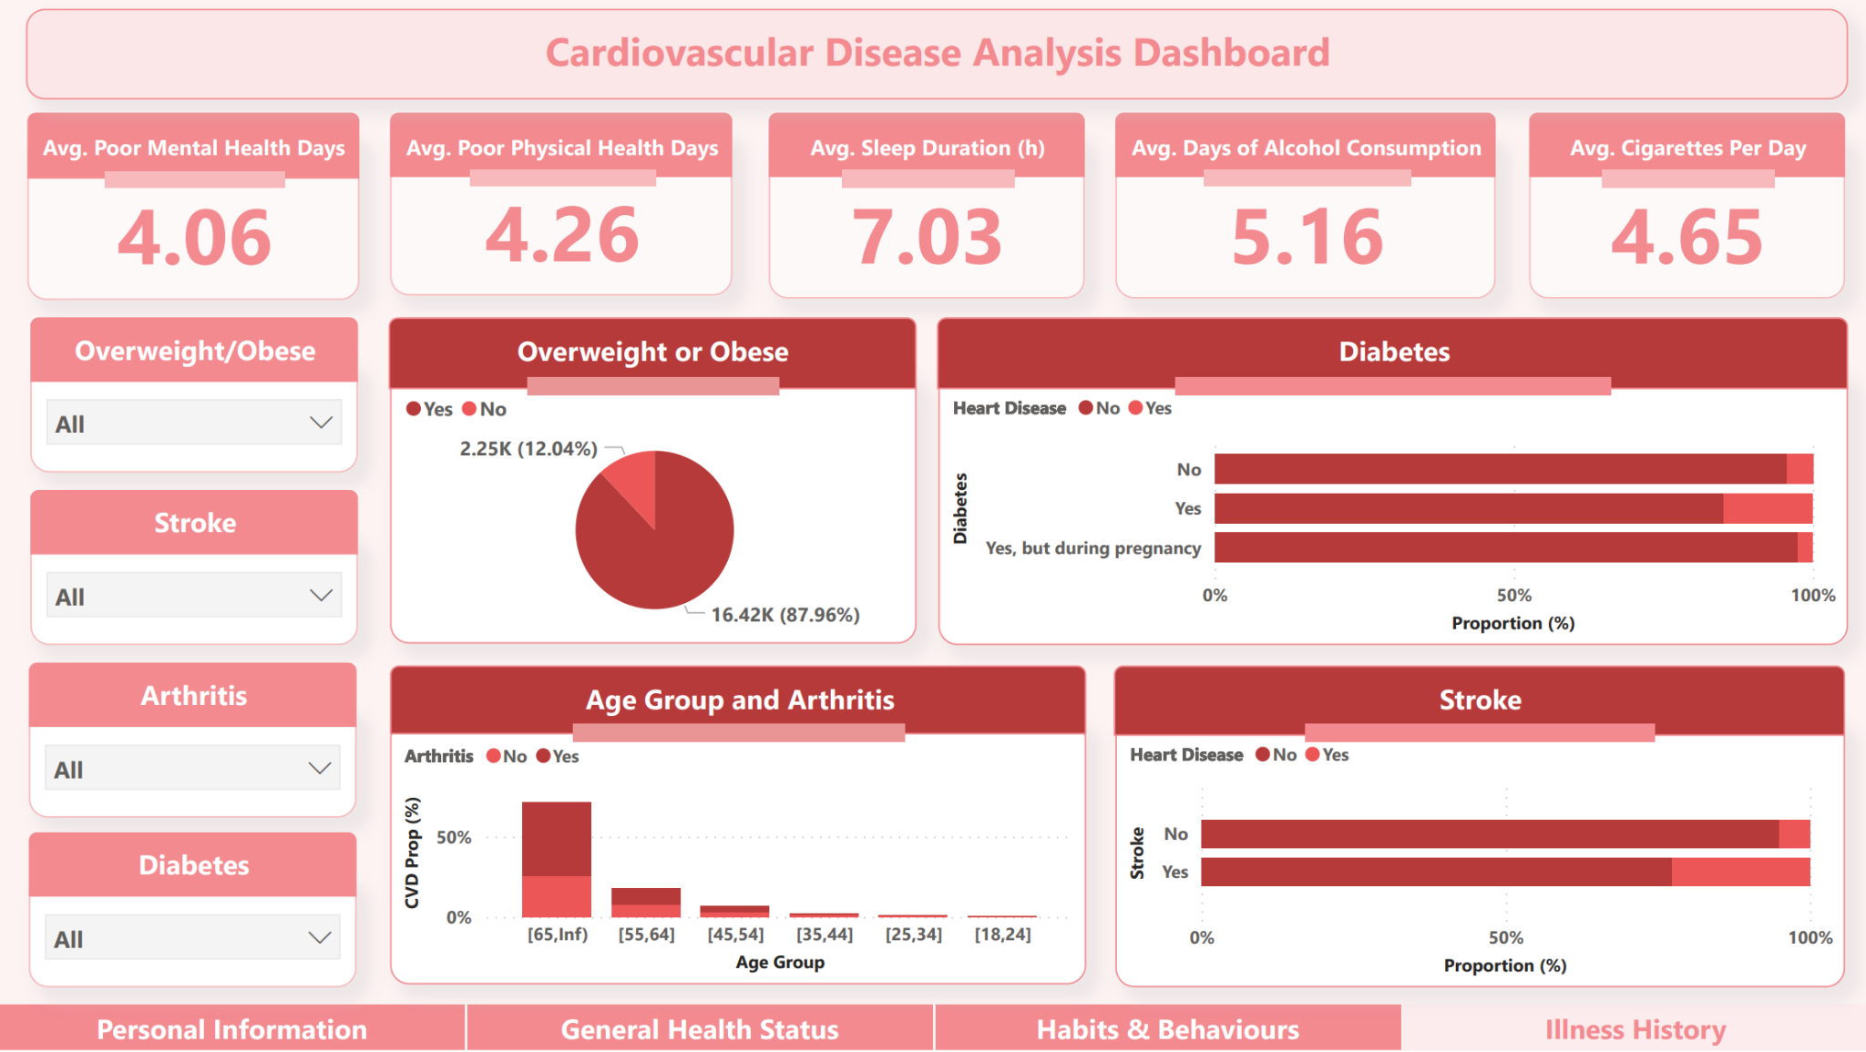
Appendix: Dashboard
Tenia

